Slide 1
Efficiency of Trees

Slide 2
Members :
Vamsi Udaykumar
Vibhav Maheshwari
Vidya.V
Vishwas S

Slide 3
Synopsis
Comparison between 3 different types of trees in terms of efficiency(no of steps).We will basically implement insertion and deletion functions for all these trees and compare which tree takes minimum no of steps to complete the following operations.
We have decided to use global variables to count the no of steps and every time the program executes the recursive function, the global variable gets incremented by 1.
Hence, in the main function we are going to compare all the global variables and display which tree is most efficient

Slide 4
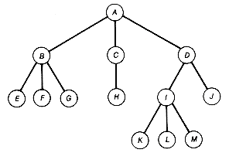
Data Structures used:
TREES

Slide 5
Types of Trees used:
AVL TREES
BINARY SEARCH TREES
B-TREES

Slide 6
Thank you

